Slide 1
Name : Emmanuel Nkateko
Surname : Mathebula
Supervisor : PS Ramalepe
Topic : Methodology of Development of Word Model Prediction for Xitsonga

Slide 2
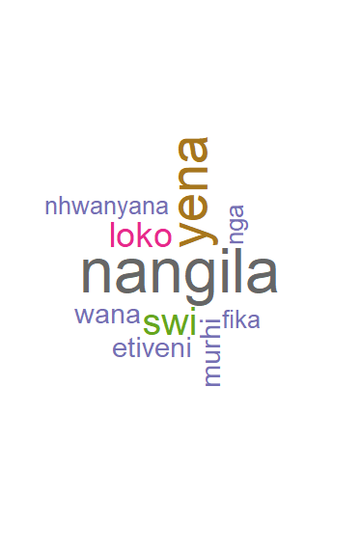
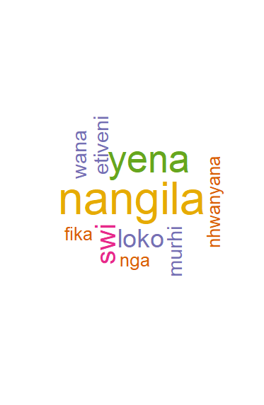
Outline
Short description of the system to be developed
Downloading Required software to build the system
Installation of the Rstudio, R programming and Rtool
Installing required libraries to clean, create wordcloud, create wordcloud, data visualization
Loading the Corpus to Rstudio
Cleaning the Corpus
Building of N-grams based on Xitsonga Corpus
The Xitsonga word prediction is build

Slide 3
Short description of the system to be developed
Extraction of corpus
Loading corpus
Cleaning the corpus
Building of N-grams
Xitsonga word prediction

Slide 4
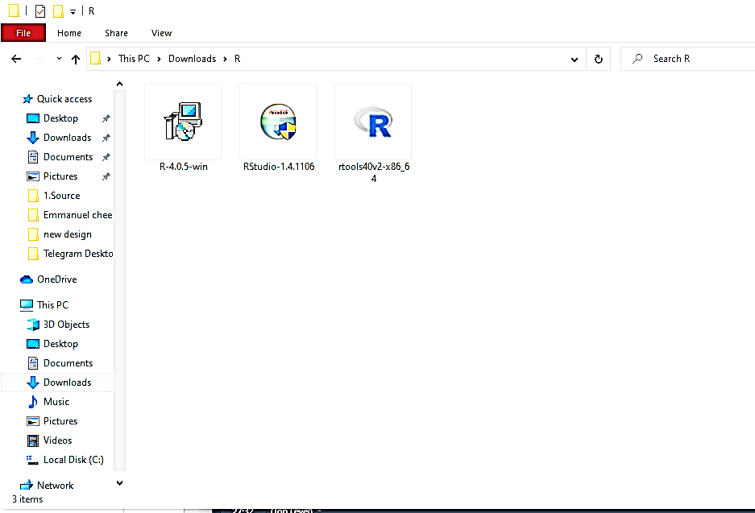
Downloading Required software to build the system
We download the:
RStudio from “rstudio.com/products/rstudio/download/” ,
R programming version R4.1.0 from https://cran.r-project.org/bin/wimdows/base/,
And finally we downloaded the Rtool version 4.0 from “https://cran.r-project.org/bin/windows/Rtools/” ,
all this software are based on windows 64-bit architecture.

Slide 5
Installation of the Rstudio, R programming and Rtool
We installed them( using installation wizard) in a PC that runs on operating system that is based on 64 bit which is Windows
After we Opened the RStudio , open new project

Slide 6
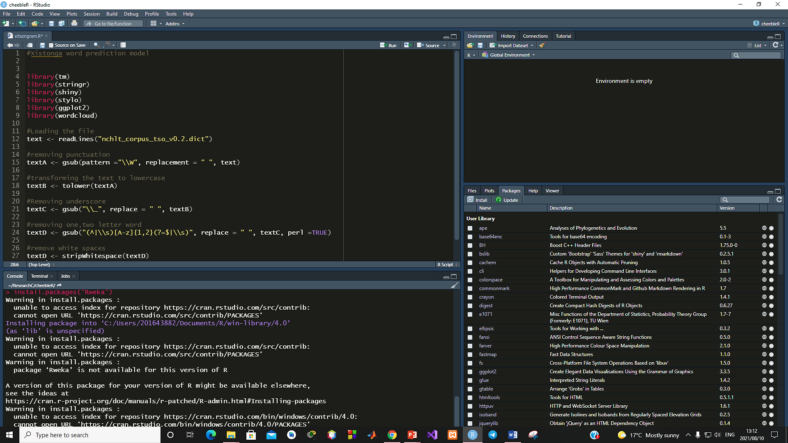
Installation of the Rstudio, R programming and Rtool

Slide 7
Installing required libraries to clean, create wordcloud, graphs, and evaluation
We open Rstudio then on the console tab
Install.packages(“tm“)
Install.packages(“ggplot2“)
Install.packages(“wordcloud“)
Install.packages(“RWeka“)
Install.packages(“stringr“)
Install.packages(“stylo“)
Install.packages(“shiny“)

Slide 8
Loading the Corpus to Rstudio
We first have to Extract the corpus from http://www.rma.nwu.ac.za/handle/20.500.12185/364
Then include the libraries in our R Script file :
library(“tm“)
library(“ggplot2“)
library.packages(“wordcloud“)
library(“RWeka“)
library(“stringr“)
library(“stylo“)
library(“shiny“)
secondly we load the corpus , using this code **xitsongaText <- readlines(“cheeble.txt”)**

Slide 9
Cleaning the Corpus
removing punctuation
xitsongaText <- gsub(pattern ="\\W", replacement = " ", xitsongaText)
removing punctuation
xitsongaText <- gsub(pattern ="\\d", replacement = " ", xitsongaText)
transforming the text to lowercase
xitsongaText <- tolower(xitsongaText)
removing one,two letter word
xitsongaText <- gsub("(^|\\s)[A-z]{1,2}(?=$|\\s)", replace = " ", xitsongaText, perl =TRUE)
Removing unwanted words in the corpus
xitsongaText <- removeWords(xitsongaText, “example”)
remove white spaces
xitsongaText <- stripWhitespace(xitsongaText)

